Slide 1
Oxygen XML Tutorial
By: Marshanah Taylor

Slide 2
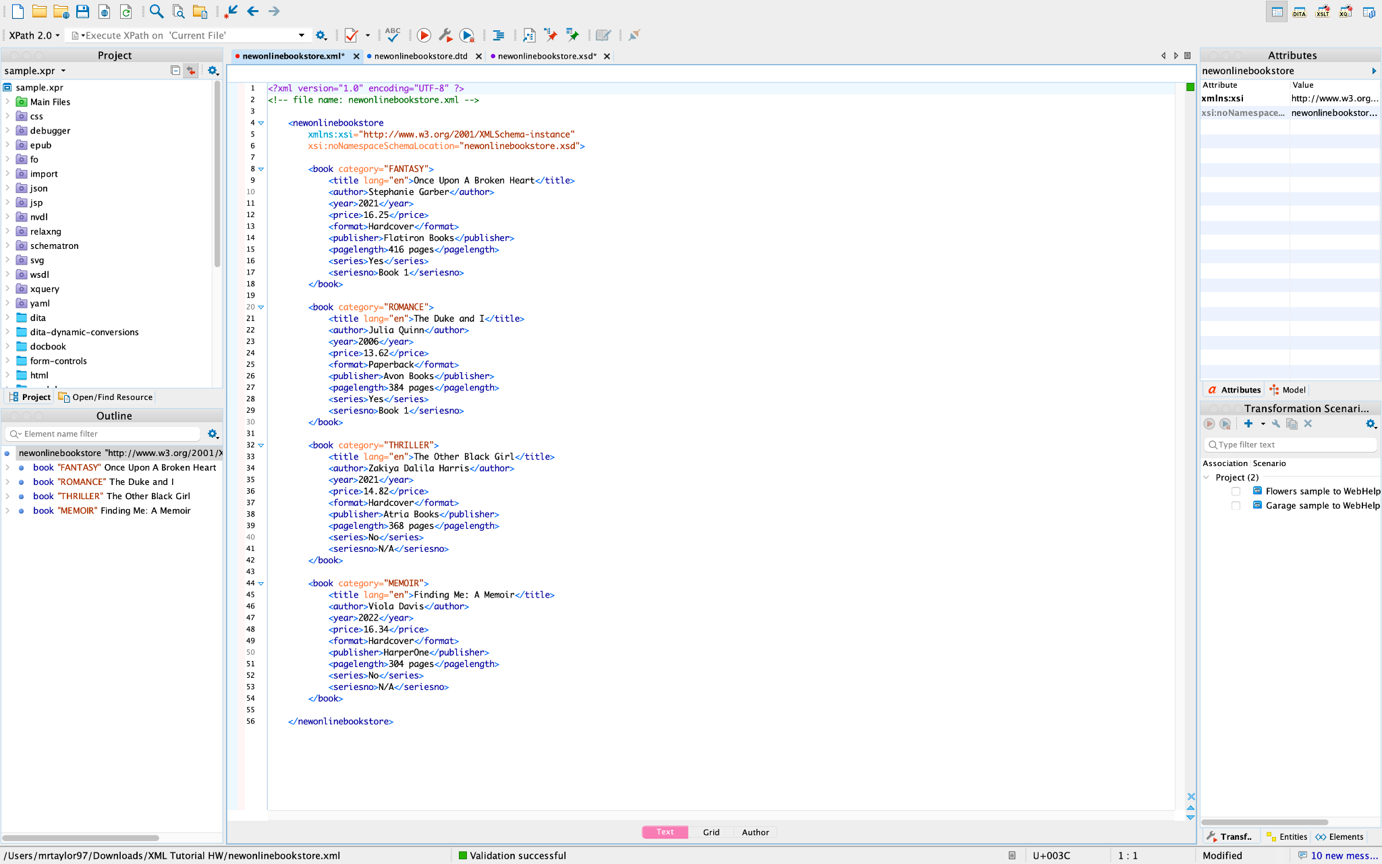
Online Bookstore (XML Example w/ Validation)

Slide 3
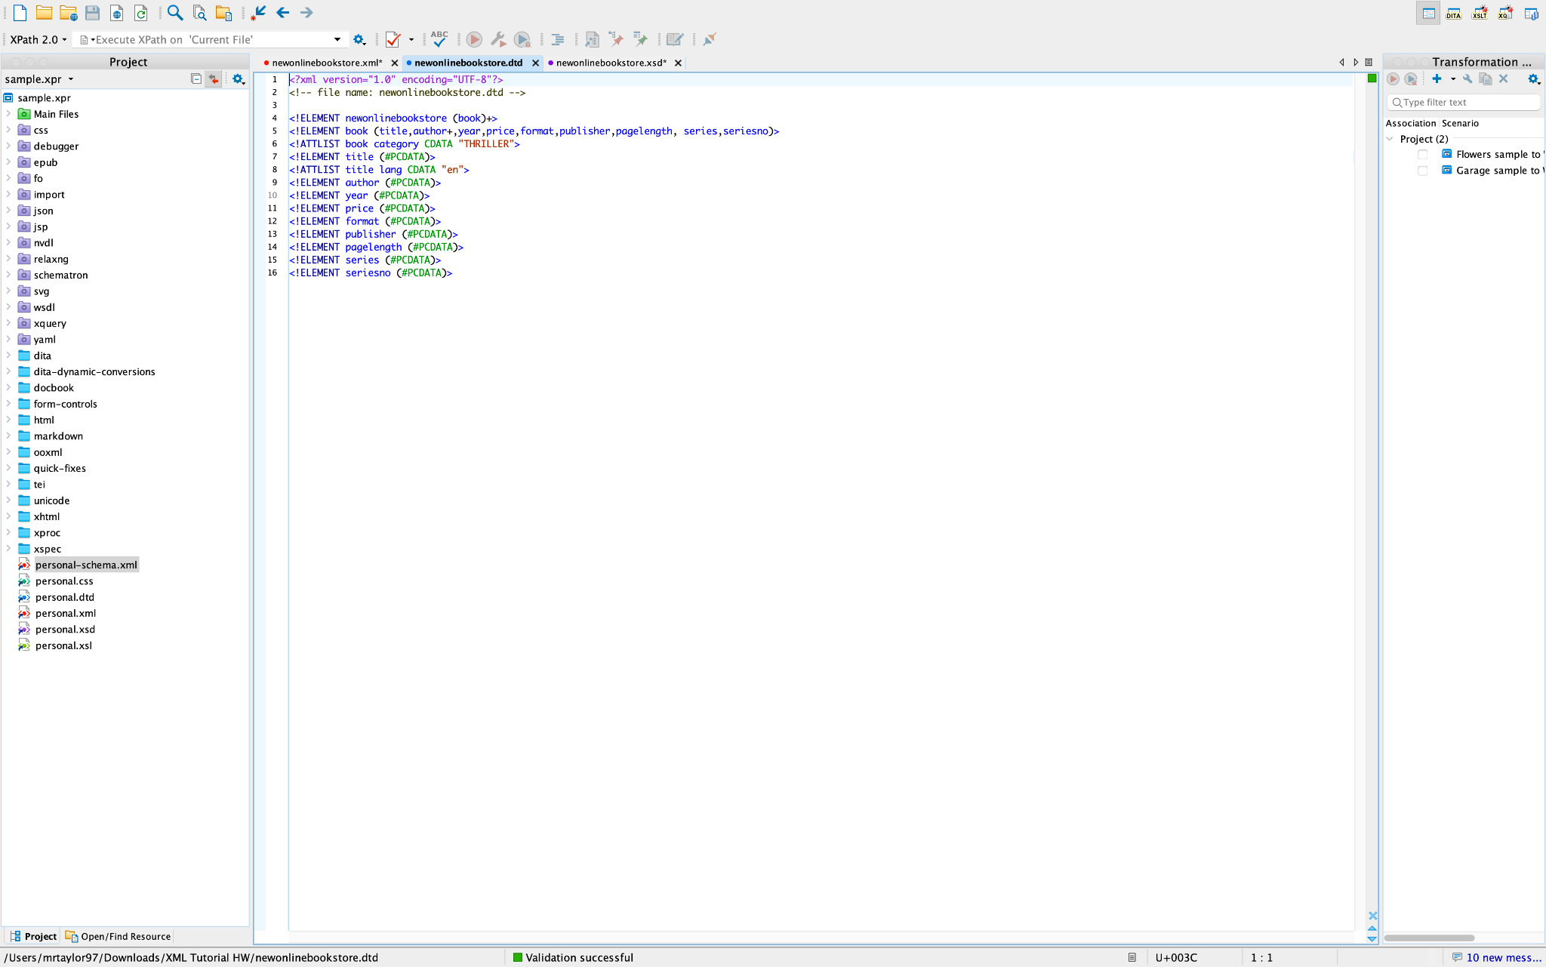
Online Bookstore (DTD Example w/ Validation)

Slide 4
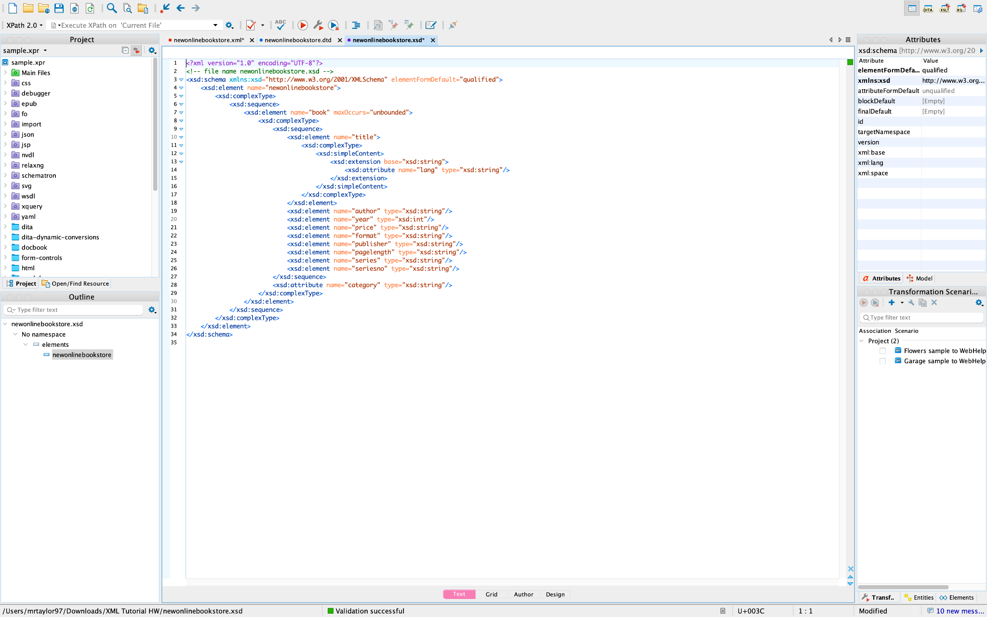
Online Bookstore (XML Schema Text w/ Validation)

Slide 5
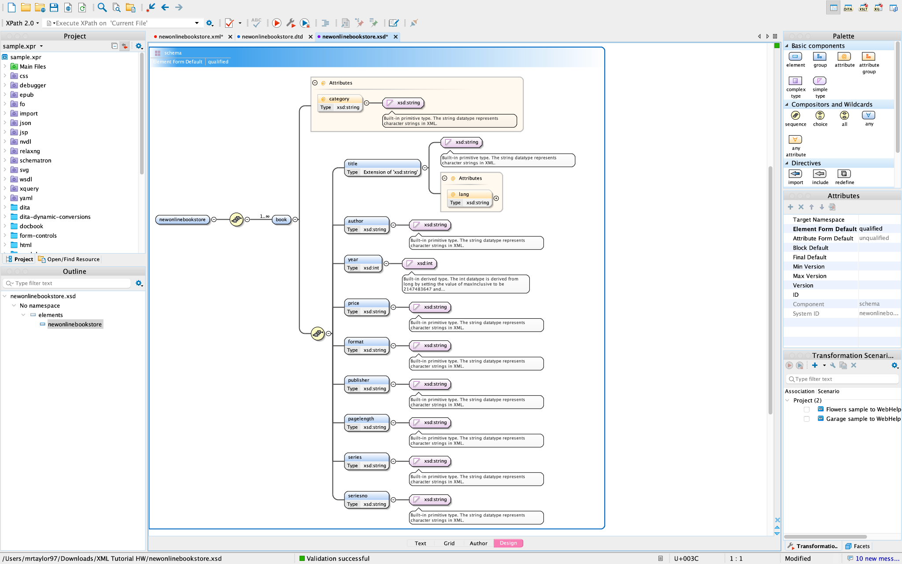
Online Bookstore (XML Schema Design w/ Validation)

Slide 6
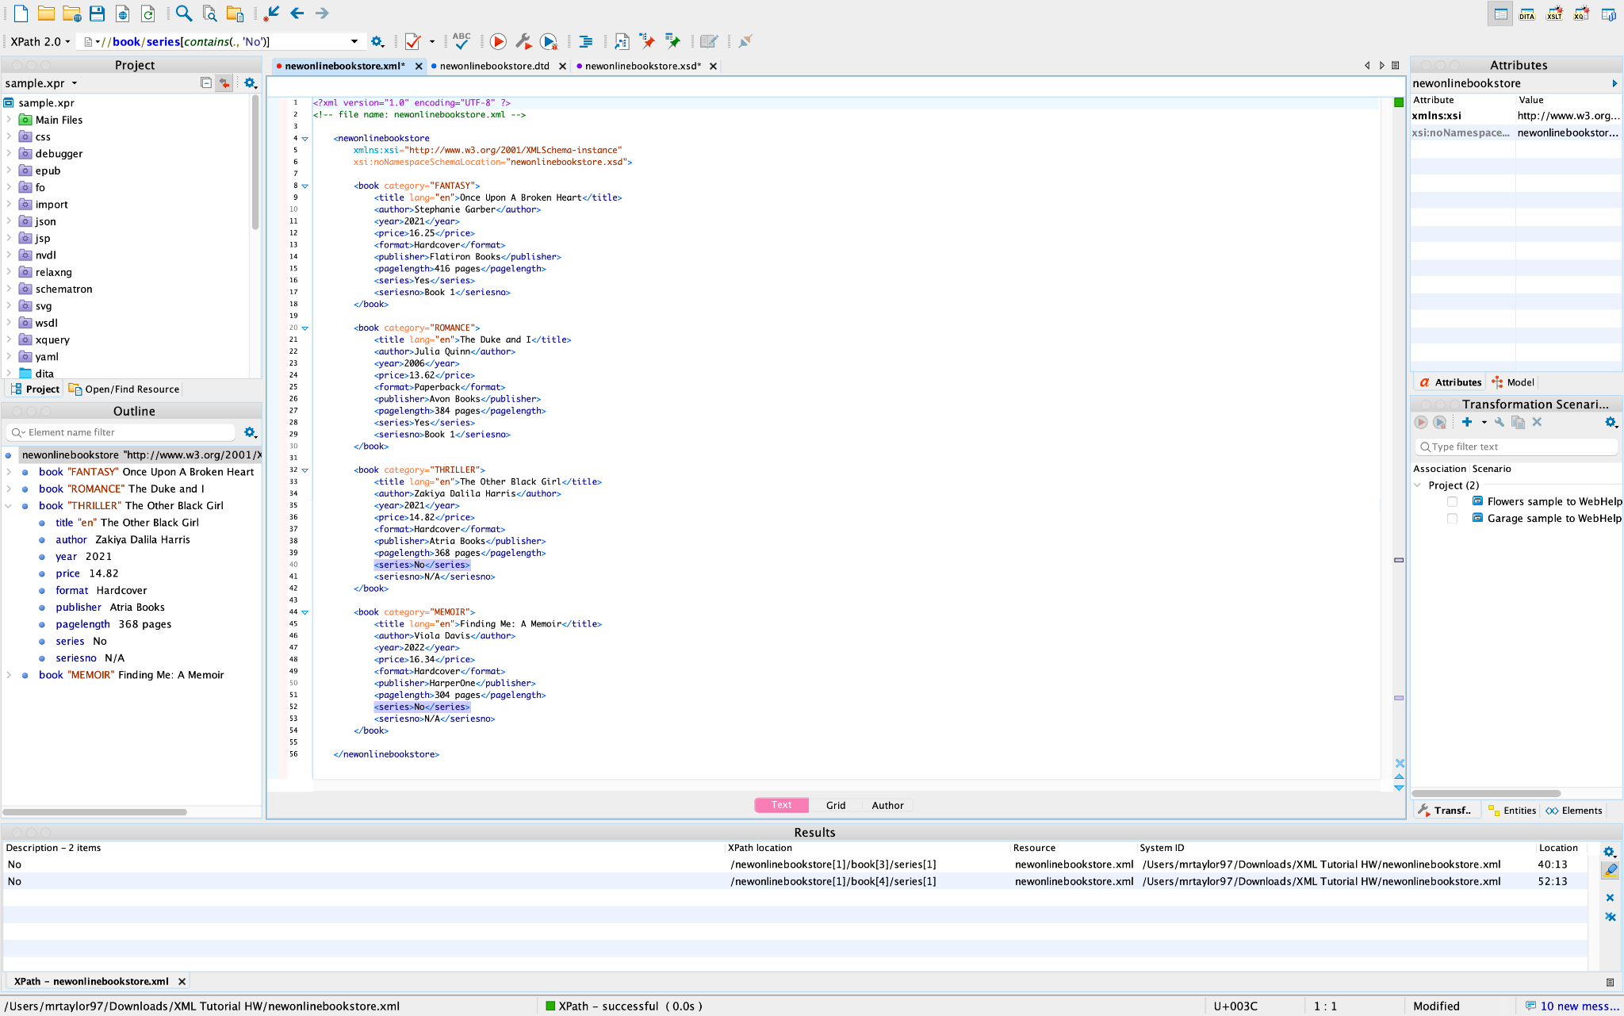
Online Bookstore (XPath Query 1 w/ Results)
Selects only the books that are not part of a series: //book/series[contains(., 'No')]

Slide 7
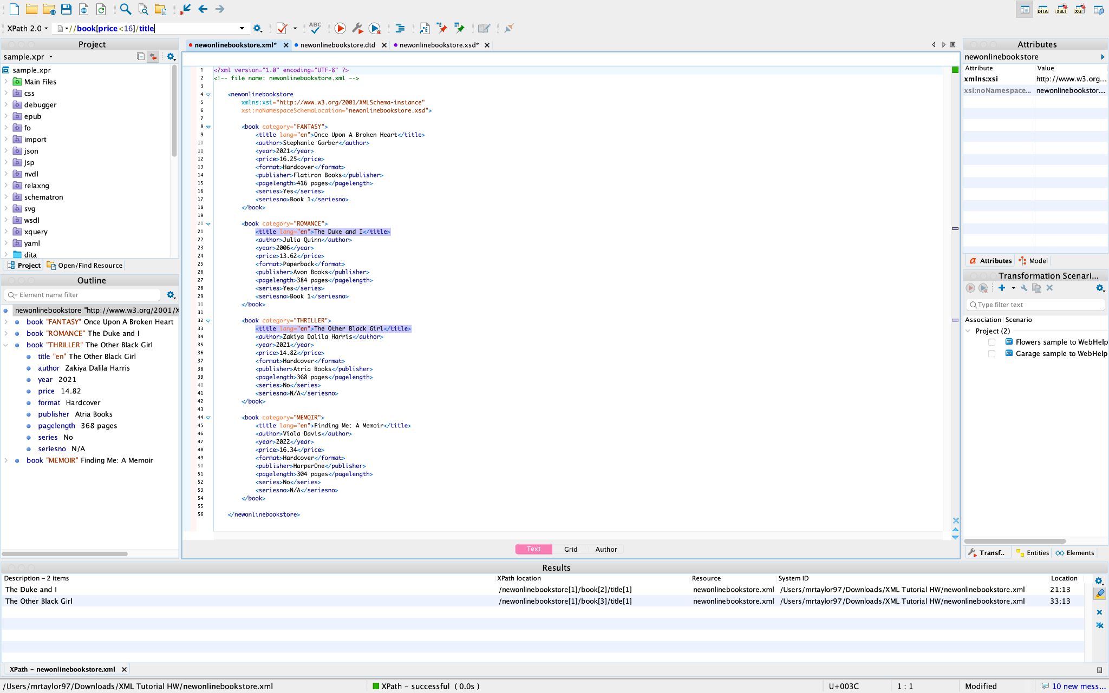
Online Bookstore (XPath Query 2 w/ Results)
Selects only the book titles that are less than $16: //book[price<16]/title

Slide 8
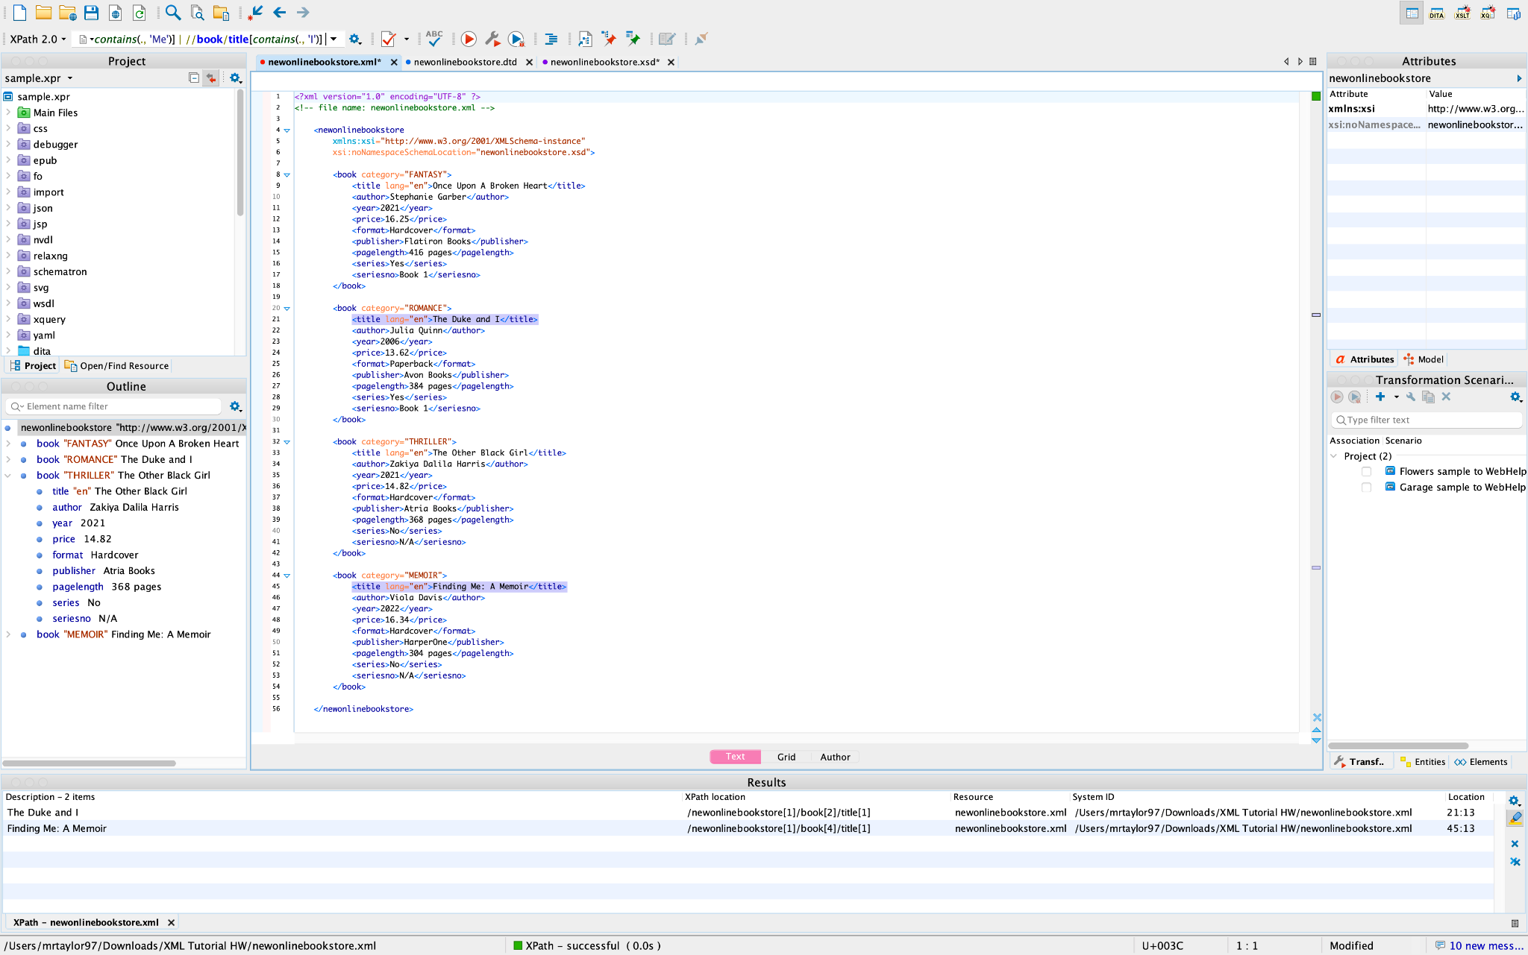
Online Bookstore (XPath Query 3 w/ Results)
Selects only the books that contain the words ‘Me’ and ‘I’ in the title: //book/title[contains(., 'Me')] | //book/title[contains(., 'I')]

Slide 9
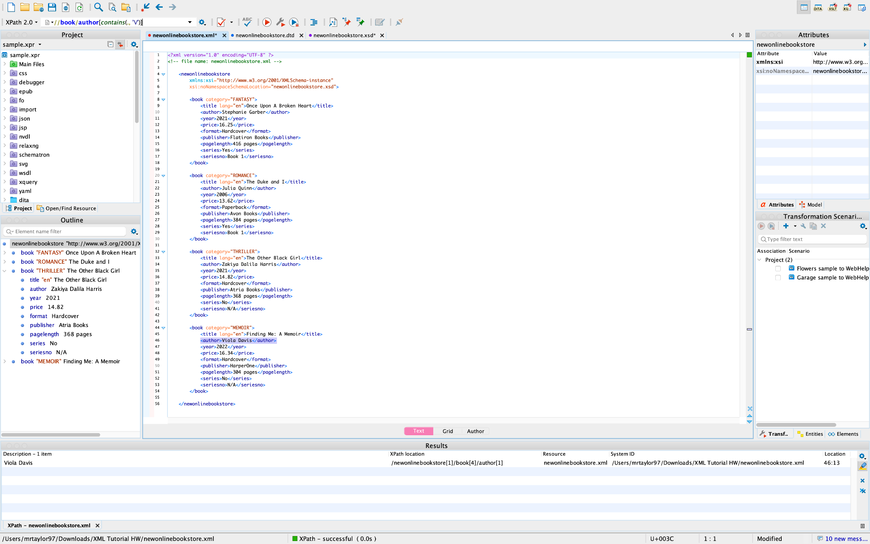
Online Bookstore (XPath Query 4 w/ Results)
Selects only the book where the author’s name contains the letter ‘V’: //book/author[contains(., 'V')]

Slide 10

Online Bookstore (XPath Query 5 w/ Results)
Selects only the book title published before 2021 with a paperback format: //book[format='Paperback' and year<2021]/title

